Slide 1
Coinfections: Old and new Re-emerging hepatitis A
Philip Yi-Chun Lo, MD
Deputy Director-General
Taiwan CDC
25 July, 2018

Slide 2
Hepatitis A -- a vaccine-preventable disease
Acute infection caused by HAV
Usually self-limited in children, more severe in adults
Case-fatality 0.1%, higher (2%) >50y/immunocompromised
Transmitted via fecal-oral route
Foodborne; waterborne
person-to-person; sexual (oral-anal)
No specific treatment available
Vaccines highly effective
Source: ECDC rapid risk assessment: hepatitis A outbreak in MSM third update 28 June 2017

Slide 3
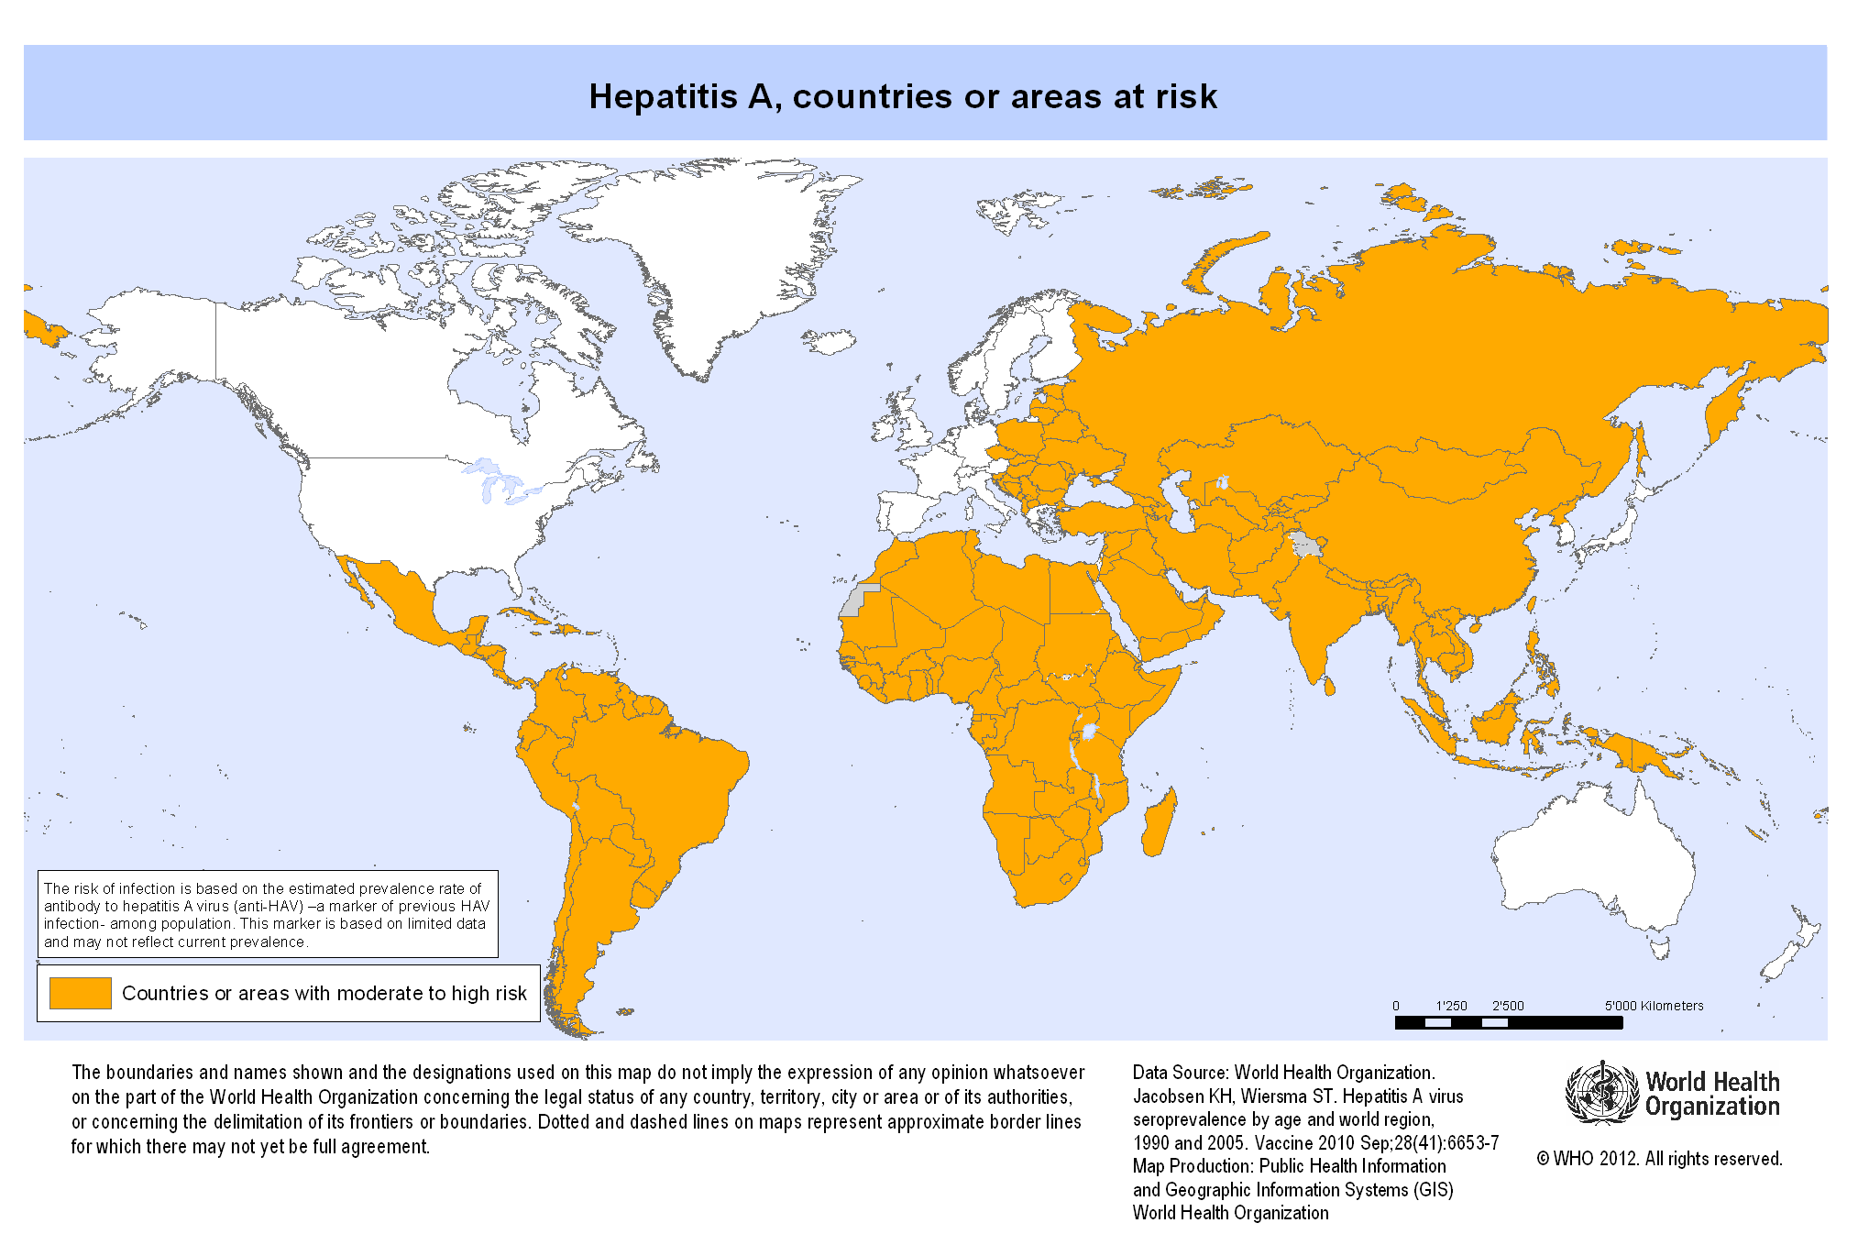
Hepatitis A, countries or areas at risk
HAV seroprevalence decreasing in low endemicity countries
Source: http://gamapserver.who.int/mapLibrary/Files/Maps/Global_HepA_ITHRiskMap.png?ua=1

Slide 4
Hepatitis A and MSM in low endemicity settings
HAV outbreaks among MSM recognized since 1970s
Europe, North America, Australia
Transmitted mainly via direct oral-anal contact during sex
Also by contact with fingers/objects that have been in/near anus of an infected person
>70% immunity among MSM needed to prevent sustained HAV transmission and control outbreaks
Inadequate vaccination rate: 21%-45%
Low seroprevalence: 14%-68% varied by age and cities
Lin KY et al. World J Gastroenterol. 2017;23:3589-3606. Review.

Slide 5
WHO Alert -- HAV outbreaks mostly affecting MSM 7 June 2017
Unusual increase since June 2016
Affecting mainly MSM
Low-endemicity countries
Sexual transmission (oral-anal)
European region
>1000 cases in 15 countries
3 multi-country outbreaks
Americas
>700 cases in Chile
Increase in NYC, USA
http://www.who.int/csr/don/07-june-2017-hepatitis-a/en/

Slide 6
Timeline of recent HAV outbreaks affecting MSM
Taiwan
1,268 cases
47% HIV(+) MSM
Genotype IA
Hong Kong
13 cases
all HIV(+) MSM
Genotype IA
22 EU countries
3,813 cases
mainly MSM
Genotype IA
Three main strains
New York City & Colorado, USA
51 cases
mainly MSM
Genotype IA
Multiple strains
California, USA
51 MSM cases
Mainly Genotype IA
1 | 2 | 3 | 4 | 5 | 6 | 7 | 8 | 9 | 10 | 11 | 12 | 1 | 2 | 3 | 4 | 5 | 6 | 7 | 8 | 9 | 10 | 11 | 12 | 1 | 2 | 3 | 4 | 5 | 6 | 7 | 8 | 9 | 10 | 11 | 12
2015 | 2016 | 2017
1 | 2 | 3 | 4 | 5 | 6 | 7 | 8 | 9 | 10 | 11 | 12 | 1 | 2 | 3 | 4 | 5 | 6 | 7 | 8 | 9 | 10 | 11 | 12 | 1 | 2 | 3 | 4 | 5 | 6 | 7 | 8 | 9 | 10 | 11 | 12
References:
Taiwan -- J Viral Hepat 2018 May 9 (in press)
Hong Kong -- CHP Communicable Diseases Watch 2017;14(3):11
EU -- ECDC epidemiological update 22 Dec 2017
Israel -- Euro Surveill 2017;22:pii:30575.
Chile -- Euro Surveill. 2018;23:pii:1800060.
New York City & Colorado -- MMWR 2017;66:999.
California -- Provider Alert 1 Dec 2017
Tel Aviv, Israel
19 cases
90% MSM
Genotype IA
Chile
>2000 cases
61% MSM
Genotype IA

Slide 7
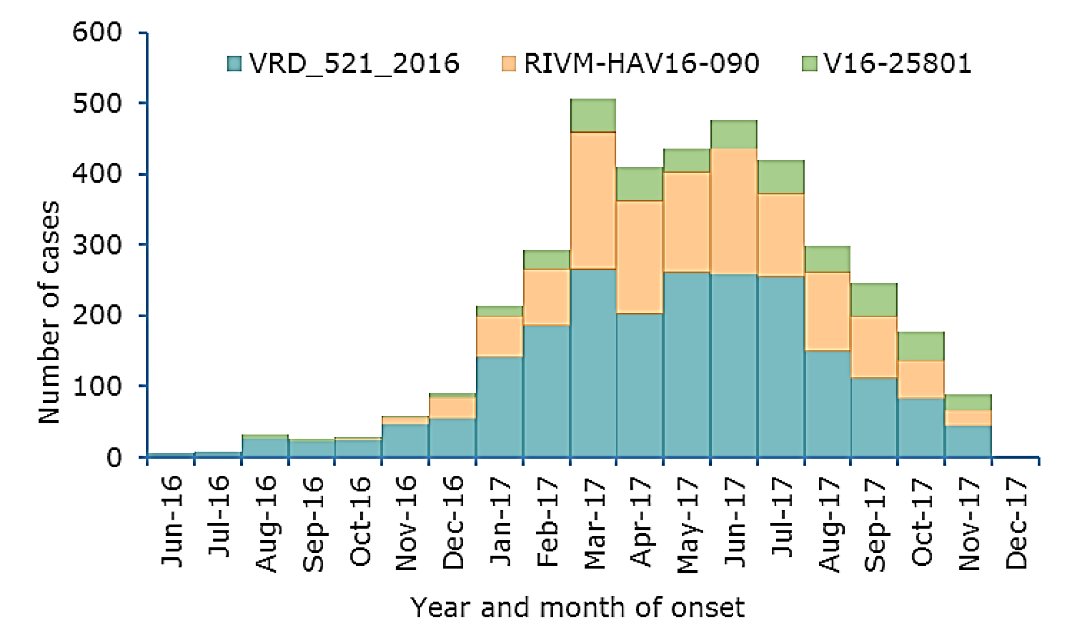
Cross-continental HAV transmission among MSM
MSM-associated HAV outbreak in 22 EU countries
Identical to 2015-16 Taiwan outbreak strain & 2017 New York City major strain
ECDC Epidemiological update: hepatitis A outbreak in the EU/EEA mostly affecting MSM, 22 Dec 2017

Slide 8
HAV outbreak among MSM in Taiwan, 2015/6-2017/12
Before outbreak
HAV seroprevalence <10% among young MSM in Taiwan
Government recommends MSM receive HAV vaccination
But…
Low awareness
No program
Cost: ~USD$100-130 for two doses
Unwillingness to disclose to healthcare providers (stigma)
References:
Seroprevalence among MSM -- J Formosan Med Assoc 2012;111:431

Slide 9
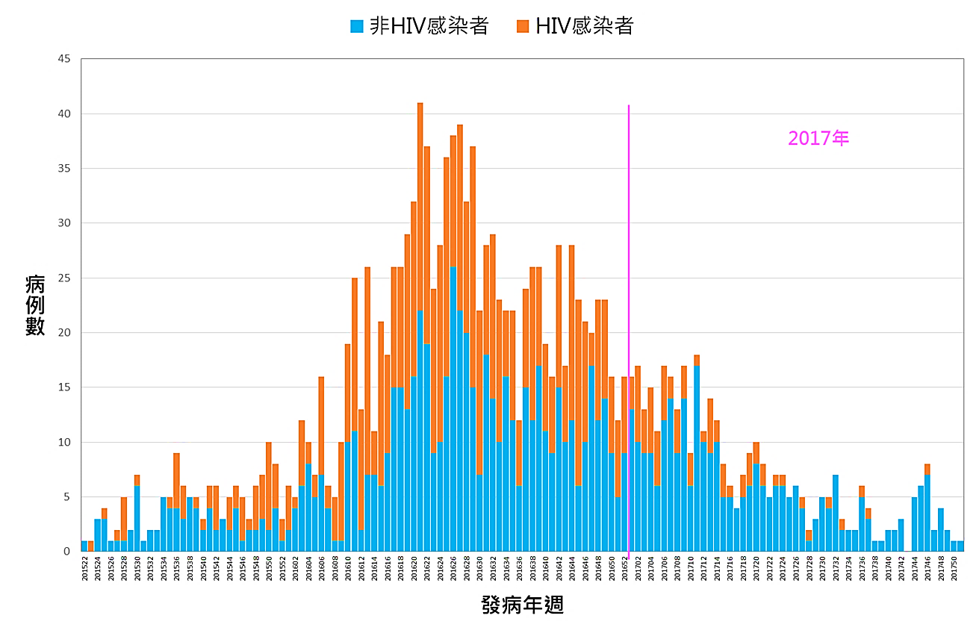
HAV outbreak among MSM in Taiwan, 2015/6-2017/12
Before outbreak
HAV seroprevalence <10% among young MSM in Taiwan
HIV(+) MSM
49%
26%
0%
2015
2016
2017
References:
Seroprevalence among MSM -- J Formosan Med Assoc 2012;111:431
HAV outbreak -- J Viral Hepat 2018 May 9 (in press)
From urban to rural

Slide 10
HAV outbreak among MSM in Taiwan, 2015/6-2017/12
Before outbreak
HAV seroprevalence <10% among young MSM in Taiwan
HIV(+) MSM
49%
Q: How can we identify at-risk population and deliver vaccine to them during a sensitive time of LGBT right campaign?
26%
0%
2015
2016
2017
vs
References:
Seroprevalence among MSM -- J Formosan Med Assoc 2012;111:431
HAV outbreak -- J Viral Hepat 2018 May 9 (in press)

Slide 11
HAV outbreak among MSM in Taiwan, 2015/6-2017/12
Before outbreak
HAV seroprevalence <10% among young MSM in Taiwan
HIV(+) MSM
49%
Free 1st dose to persons with HIV, syphilis or gono
26%
20%
0%
1%
2015
2016
2017
References:
Seroprevalence among MSM -- J Formosan Med Assoc 2012;111:431
HAV outbreak -- J Viral Hepat 2018 May 9 (in press)
From urban to rural

Slide 12
Vaccine coverage (≥1 dose) among persons with HIV, syphilis or gonorrhea during HAV outbreak in Taiwan
HIV, syphilis, or gono
HIV
Target
Syphilis or gono
453 hospitals
1,001 physicians
18,148 recipients
Source: Taiwan CDC unpublished data

Slide 13
HAV outbreak among MSM in Taiwan: Lessons learned
High vaccine coverage was crucial to outbreak control
Vaccination rate among MSM with HIV in Taipei increased from 4.7% to 70.6% within one year
Steep decline of incidence seen after proportion of immune subjects reached 65%
Vaccine was effective among persons with HIV
Vaccine effectiveness 96.3%; seroconversion rate higher with younger age and with undetectable viral load
More than HAV to deal with
Coinfection common – syphilis, gonorrhea, HCV, shigellosis
35 HAV patients newly diagnosed with HIV
Liver Int. 2018;38(4):594 Hepatology 2018;68(1):22 J Viral Hepat 2018 May (in press);

Slide 14
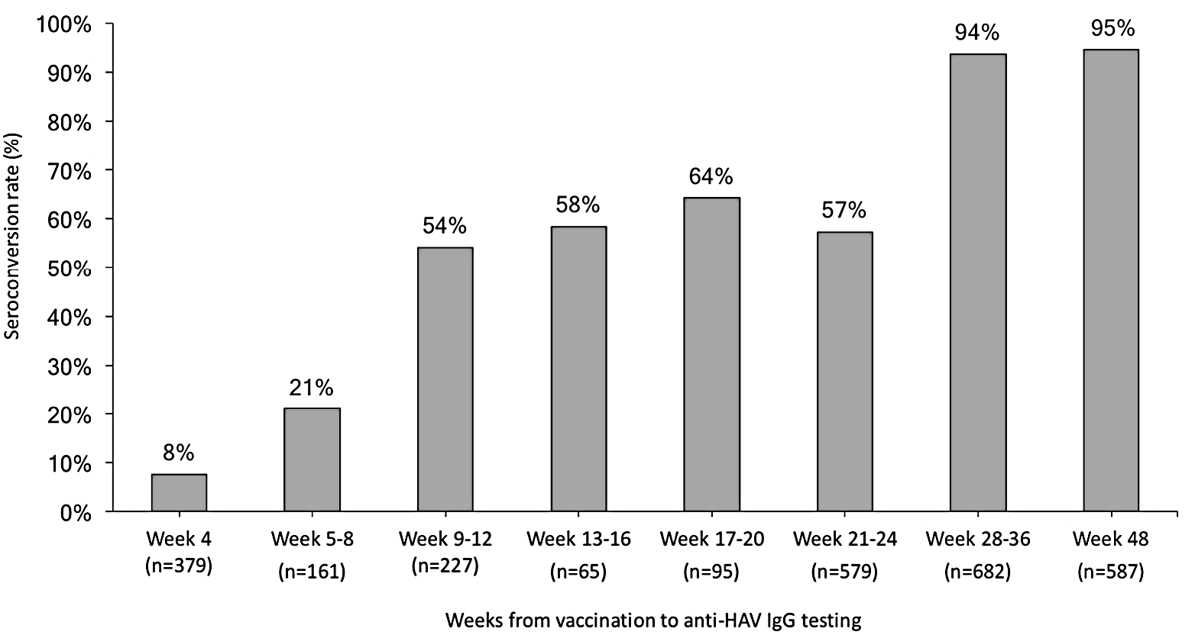
How good and how soon is serologic response after HAV vaccination among persons with HIV?
Serologic response is delayed
Before 2nd dose -- about 60%
After 2nd dose -- >90%
Second dose
First
dose
Hepatology 2018;68(1):22

Slide 15
Vaccine issues for persons with HIV: Lessons learned
Breakthrough HAV infection after vaccination
5 cases out of 1,001 vaccines (0.5%) vs. 11% of 532 non-vaccinees
All received one dose only
Illness onset ranged from 1 to 6 month after vaccination
Vaccine interchangeability
HAVRIX®-VAQTA® vs. VAQTA®-VAQTA® similar seroconversion rates at weeks 28-36 (82% vs 81%) and week 48 (95% vs 94%)
How long can vaccine protection last?
88% vaccinees still had adequate seroprotection after 5 years
Hepatology 2018;68(1):22; J Infect Dis. 2018 Apr (in press); J Infect Dis. 2017;215(4):606

Slide 16
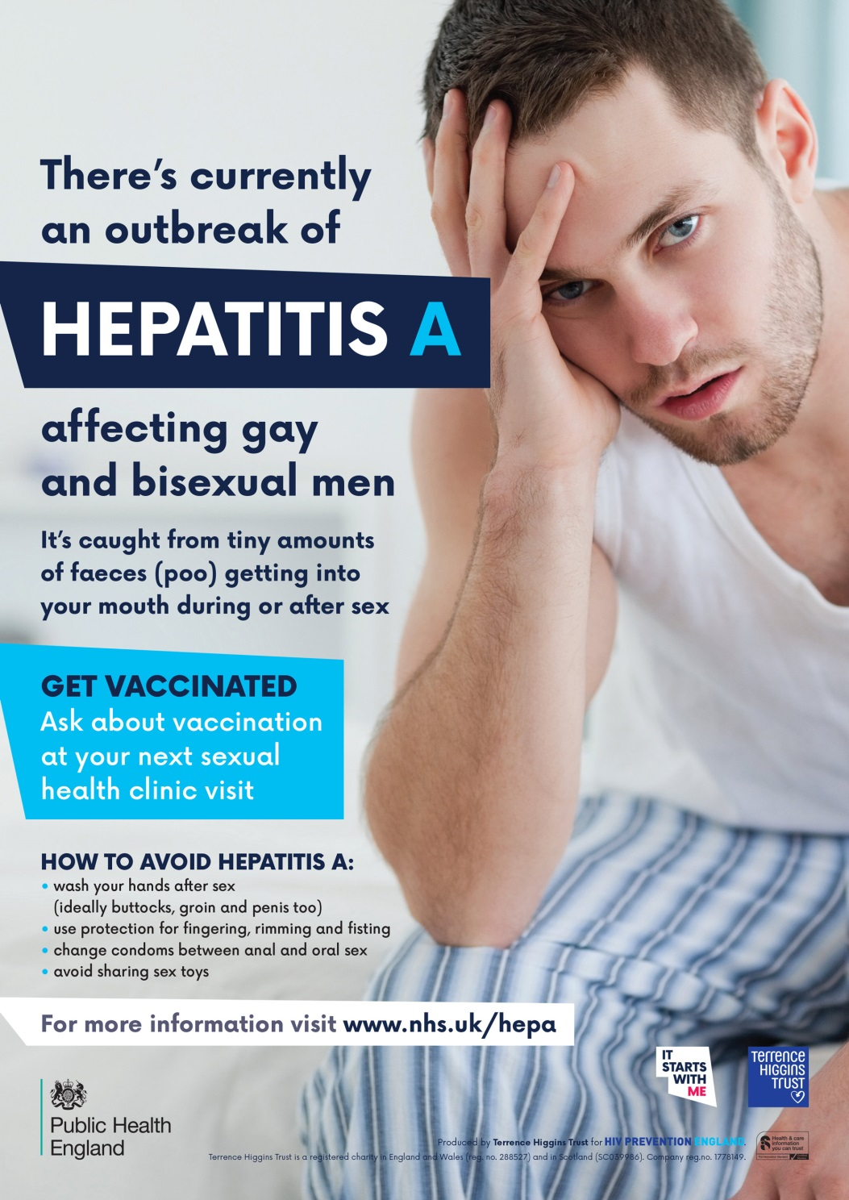
UK
Hong Kong

Slide 17
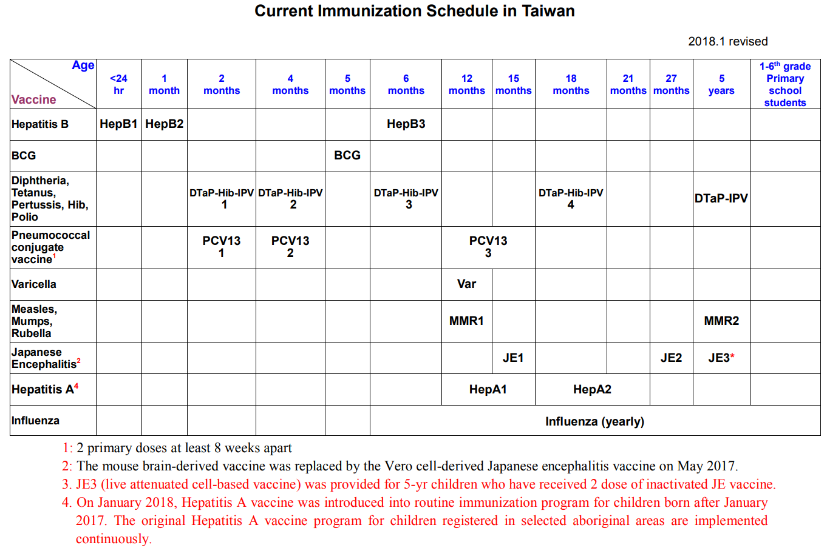
Hepatitis A vaccine as EPI in Taiwan after January 1, 2018

Slide 18
Relevant oral / poster abstracts in AIDS 2018
HAV vaccine effectiveness among persons with HIV during 2015-17 outbreak in Taiwan
presented by Dr. Kuan-Yin Lin
HAV disease less severe but prolonged course with HIV coinfection
presented by Dr. Yu-Lin Li
on Thursday 14:30-16:00 HIV and the liver (oral abstracts)

Slide 19
Conclusions
Reemerging HAV outbreaks among MSM highlights the importance and effectiveness of vaccination programs
Targeted (towards MSM) vs. universal (childhood)
The trigger of the outbreak remained unclear
Why did it occur in 2015-2017?
Role of recreational drug use / “chemsex”?
Socio-behavioral factors yet to be determined
2-dose vaccines highly effective among persons with HIV

Slide 20
Shigellosis & HAV cases among HIV-infected adults— Taiwan, Jan 2015–Apr 2016
No. cases
*4 cases with both infections
Illness onset
Notes:
This graph shows the trend of shigellosis and acute hep A cases among HIV-infected adults since 2015. By the end of this April, 64 cases of shigellosis and 173 cases of hep A have been reported, whereas less than 5 of each were reported before 2015. The outbreaks are still ongoing.

Slide 21
Shigellosis & HAV cases among HIV-infected adults— Taiwan, Jan 2015–Apr 2016
Shigellosis
HAV
Age
MSM=98%
MSM=99%
Notes:
The hep A and shigellosis cases were very similar in geographic areas, sex, and age. The vast majority lived in north Taiwan, mainly in the Taipei metro area. All were male and mostly young MSM at the age of 19 to 30.

Slide 22
HIV + shigellosis: case-control study
Sexual practices / drug use in the past one year?
Variables | Case n=20 | Control n=60 | Adjusted OR (95%CI)
Oral-to-anal sex | 17 (85%) | 11 (19%) | 15.5 (3.6-66.7)
Chemsex | 13 (62%) | 8 (13%) | 5.6 (1.4-22.7)
Poppers use | 14 (70%) | 11 (19%) | 10.9 (1.9-64.2)
Sex Transm Infect. 2018 Mar (in press)
Notes:
Of 19 (95%) cases and 40 (67%) control subjects who had anal intercourse within previous 12 months.
Compared with control subjects, cases had a significantly higher proportion of having ≥ 6 sexual partners, sought casual sex partners online, engaged in anal intercourse, engaged in oral intercourse, engaged in oro-anal contact, and engaged in chemsex in the previous 12 months.

